Slide 1

Text Emotional Classification-LLM

Slide 2
Project Leadership
Ritendu Bhattacharya
Data Scientist @ 360DigiTMG | Python, Data Science
Hyderabad, Telangana, India

Slide 3
Team Members
Name: Nandini Somu
nandinisrinivas852@gmail.com

Slide 4

Contents
Business objective
Business Constraints
Project Architecture
Data collection and details
Exploratory Data Analysis
Visualization
Modeling
Evaluation
Deployment
Notes:
Change

Slide 5
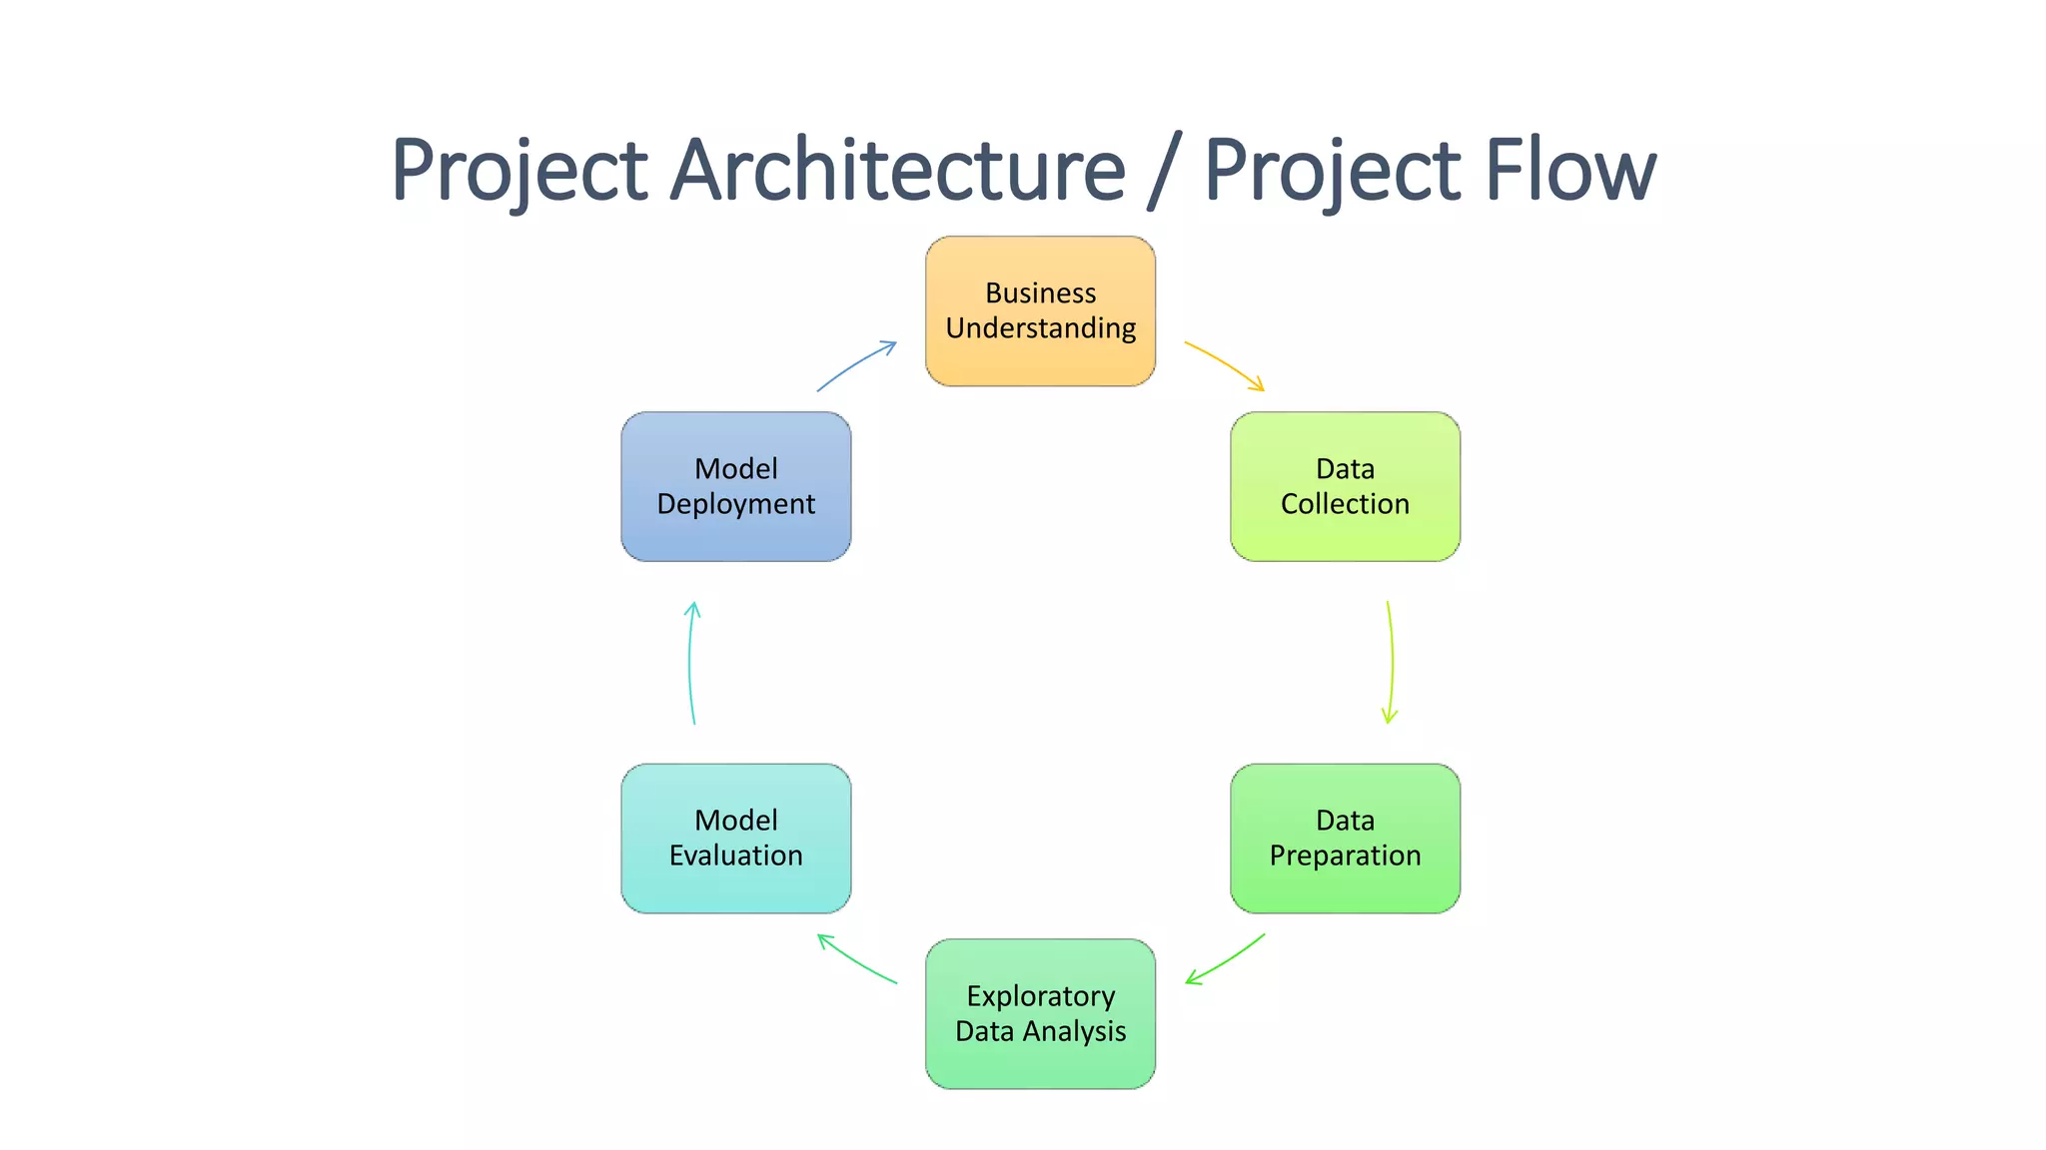
Project Overview and Scope

Slide 6
Business Problem
In the competitive landscape of tendering, securing contracts relies significantly on offering competitive pricing. However, accurately determining the optimal bid amount can be challenging, especially without insights into competitors' pricing strategies. Consequently, our client faces the dilemma of losing tenders due to overpricing or risking profit margins by Underpricing.

Slide 7
Business Objective
Objective
Constraints
Minimizing the potential loss of profit margins through the development of a data-driven pricing strategy.
Maximize the win rate of Tender contracts

Slide 8
CRISP-ML(Q) Methodology
There are six stages of CRISP-ML(Q) Methodology
1.Business and data understanding
2.Data preparation
3.model building
4.Model evaluation
5.Model deployment
6.Monitoring and maintenance

Slide 9
Technical Stacks
Operating System: Windows 11
Programming Language: Python (Spyder app is used)
Database: MySQL Workbench
Web Framework: Streamlit

Slide 10
Data Collection and Understanding
Data was collected from the secondary source.
Dataset has 2 columns and 7473 rows.

Slide 11
Data Information
Data has 2 columns both are categorical.

Slide 12
Data Dictionary
Total Rows: 7473
Columns: 2 (Text, Emotions)
Purpose: The dataset can be used for sentiment analysis, emotion detection, and related natural language processing tasks

Slide 13
System Requirements
Hardware Requirements:
Adequate CPU, RAM, and storage space.
Optionally, a GPU for accelerated deep learning tasks.
Software Requirements:
Python as the primary programming language.
Relevant ML libraries and frameworks (e.g., TensorFlow, scikit-learn).
Development environment (e.g., Jupyter Notebook, PyCharm).
MySQL Workbench for database connection
Compatible operating system (e.g., Windows, macOS, Linux).
Dependencies and Packages:
Use package managers like pip or conda to install necessary dependencies.
Consider setting up a virtual environment for managing project-specific dependencies.
Internet Connection:
Ensure a stable internet connection for downloading datasets, models, and libraries.
Access online resources and community support.
Scalability Considerations:
Cloud computing resources or distributed computing frameworks for large-scale or computationally intensive tasks

Slide 14
Exploratory Data Analysis [EDA]
Index:0 to 7472, rows 7473
Data columns (total 2 columns):
0 Emotion 7473 non-null object
1 Text 7473 non-null object
Notes:
EDA is used for seeing what the data can tell us before the modeling task.
Change

Slide 15
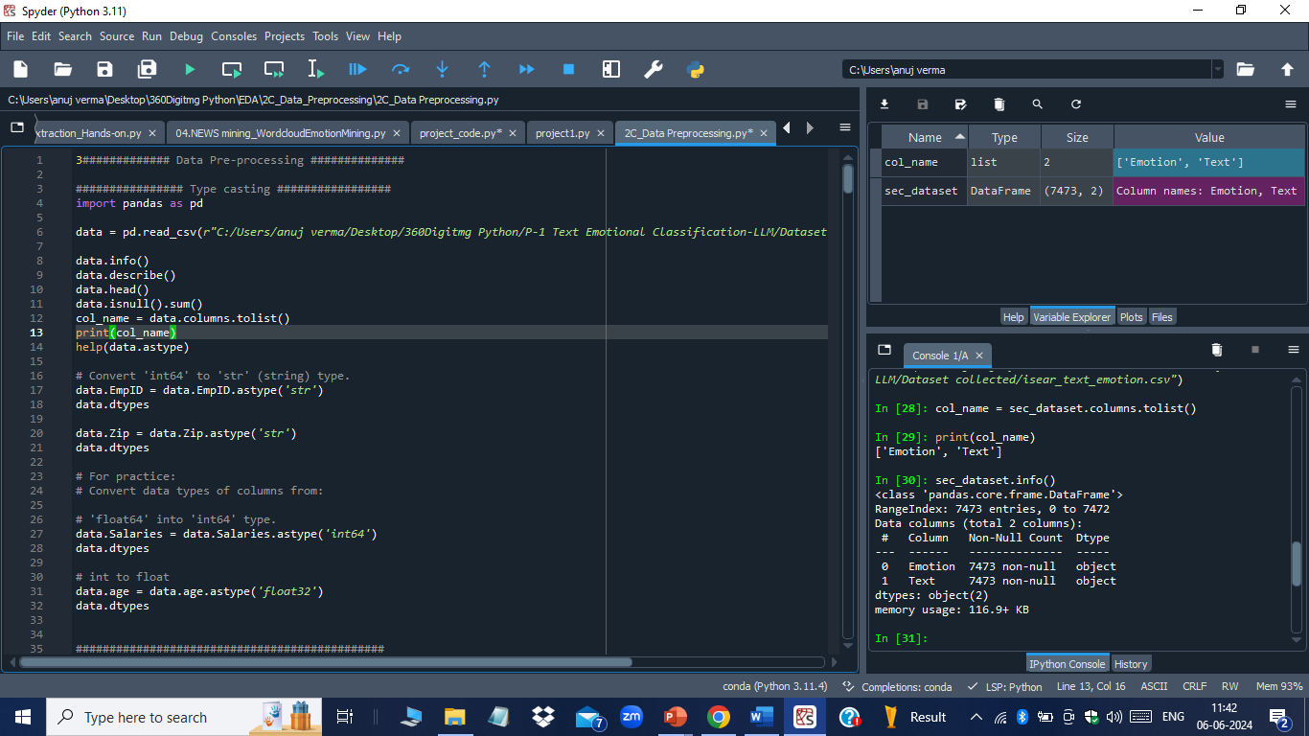
Missing Values Observation

Slide 16
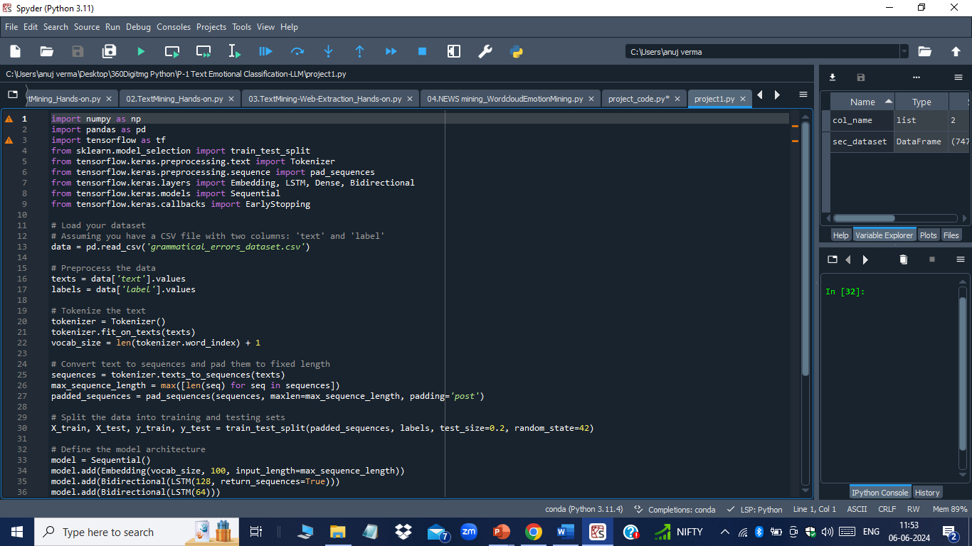
Data Preprocessing
Notes:
Keep observations

Slide 17
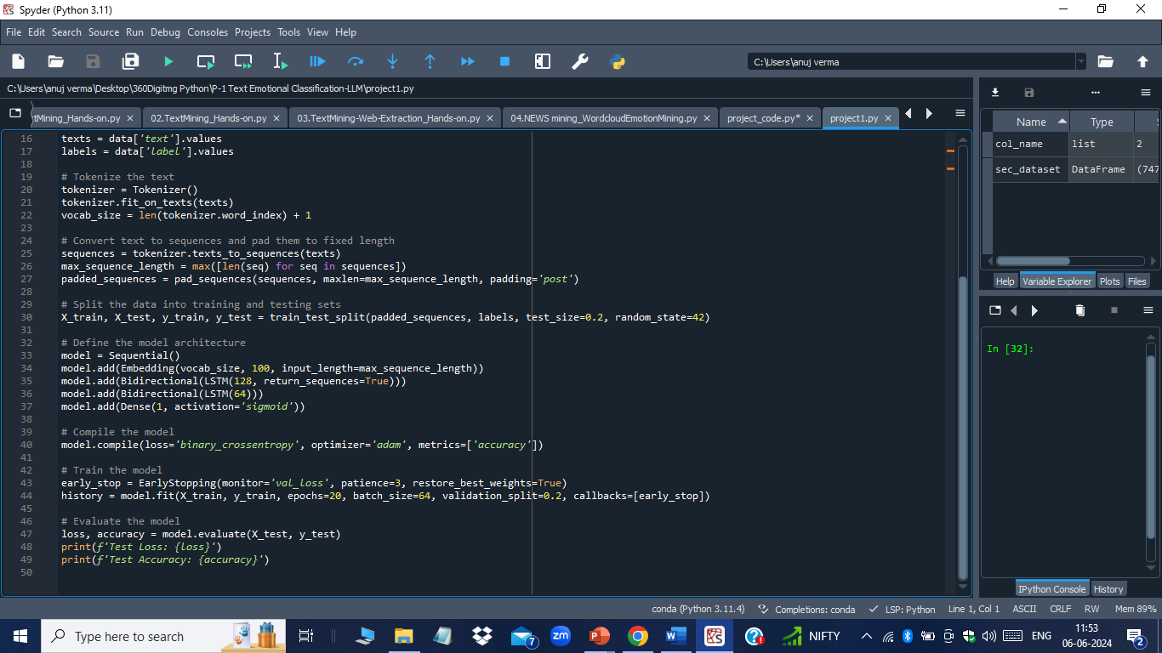
Data Preprocessing

Slide 18
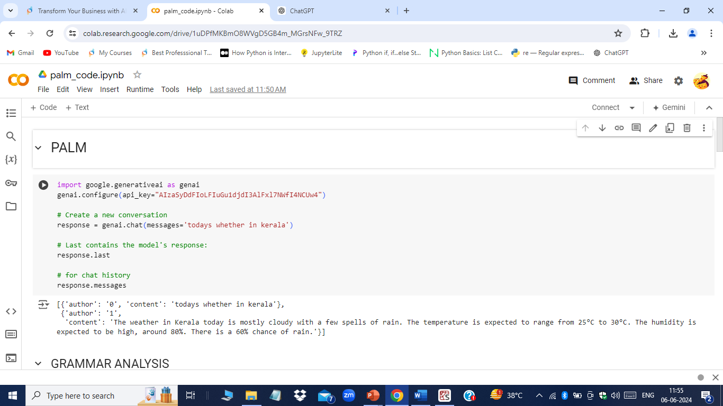
Model Building
Notes:
classification is the task of predicting a discrete class label. Regression is the task of predicting a continuous quantity.
What is classification techniques in machine learning?
The Classification algorithm is a Supervised Learning technique that is used to identify the category of new observations on the basis of training data. In Classification, a program learns from the given dataset or observations and then classifies new observation into several classes or groups.
What is regression techniques in machine learning?
Regression is a technique for investigating the relationship between independent variables or features and a dependent variable or outcome. It's used as a method for predictive modeling in machine learning, in which an algorithm is used to predict continuous outcomes.

Slide 19
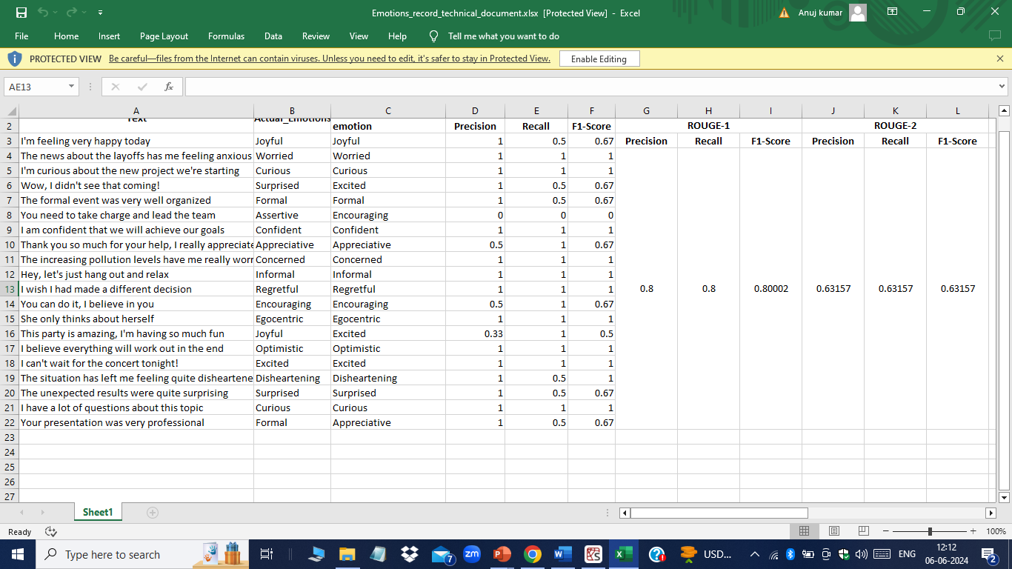
Model Accuracy Comparison

Slide 20
Best Model –
I choose Gemini as a best model
Notes:
Why Random Forest Regression is good?
A Random Forest Regression model is powerful and accurate. It usually performs great on many problems, including features with non-linear relationships
How is XGBoost different from random forest?
One of the most important differences between XG Boost and Random forest is that the XGBoost always gives more importance to functional space when reducing the cost of a model while Random Forest tries to give more preferences to hyperparameters to optimize the model..
n_estimators — the number of decision trees you will be running in the model

Slide 21
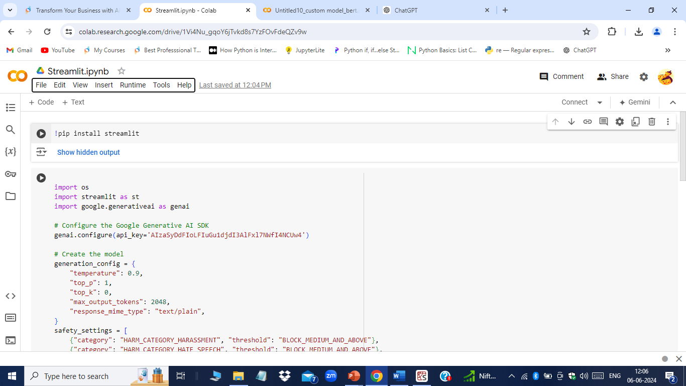
Model Deployment - Strategy
I have used streamlit as the web framework for doing the deployment.

Slide 22
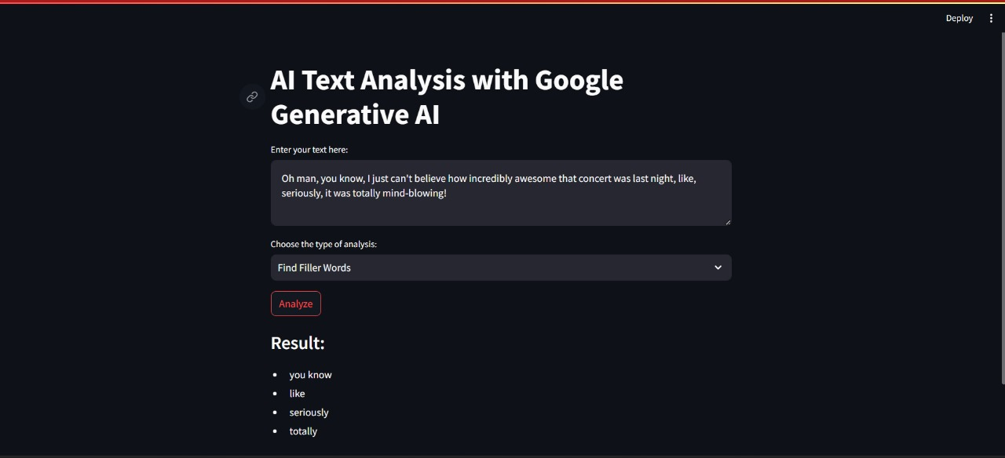
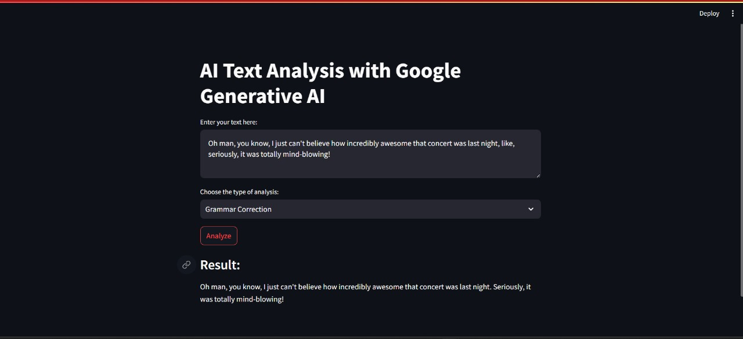
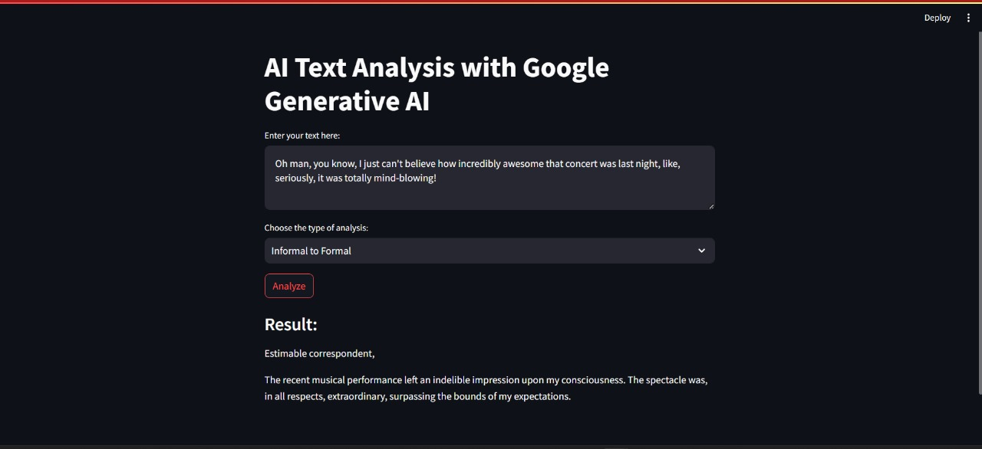
Screen shot of output

Slide 23
Challenges
Challenges include ensuring data quality, selecting relevant features and models, avoiding overfitting, interpreting results, managing computational resources, deploying models.

Slide 24
Future Scopes
In the future, data science is expected to advance in areas such as AI, ML, big data analytics, IoT, deep learning, data privacy, automation, healthcare analytics, and finance. These advancements will drive innovation and impact across industries, shaping the future of technology and decision-making.

Slide 25

Queries ?

Slide 26


